Slide 1
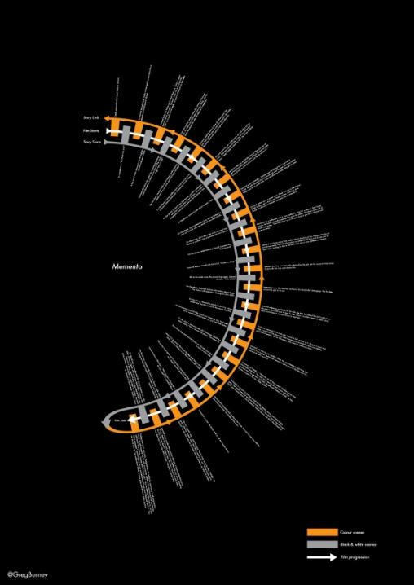
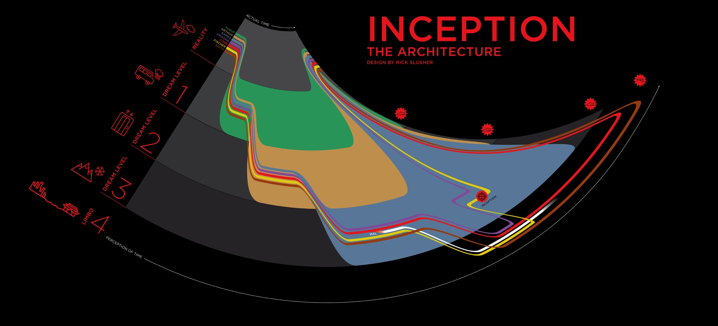
Visualizing A Woolf Novel
Examples & Ideas
ENG 410
Brought to you by:

Slide 2
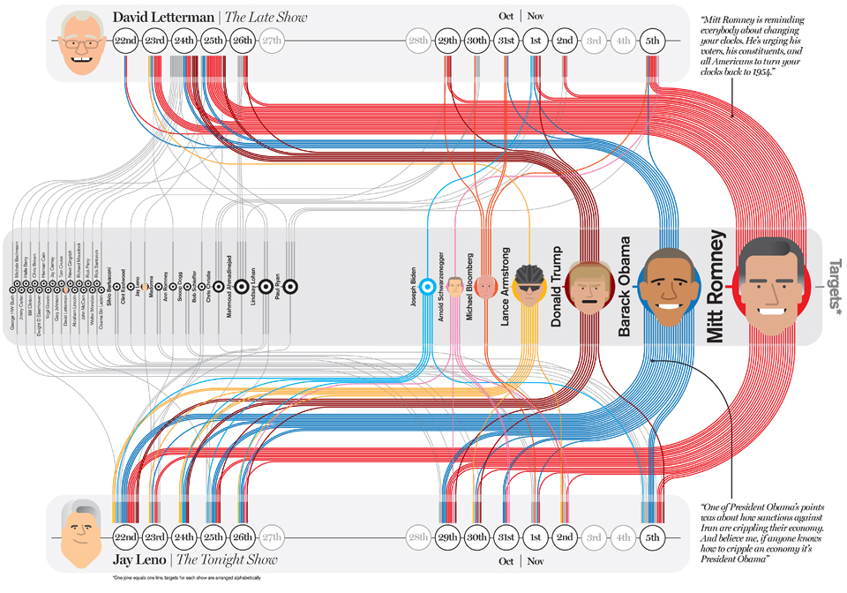
Notes:
What if instead of Barack & Mitt’s heads there were thematic topics (like “The War,” “Percival,” “Family,” “Meditation on Death,” etc.) and instead of dates, there were characters from the novel. This could be a way to visualize which characters are focused on which themes: consider dividing the characters (between the ones on the top and the ones on the bottom or left to right) to make compelling arguments about their position/ role in relationship to other characters/ gender/ age/ etc.

Slide 3
Notes:
Hierarchy of landscape: how do characters progress through different landscapes? How would you define these landscapes and how is their movement through them relevant to the novel?

Slide 4
Notes:
Movement forward in time and backwards in time: Mrs. Dalloway. Need more through lines to represent key characters? Color code details (not much text!) to the key characters?

Slide 5
Notes:
What sort of axis would be important for your novel (instead of “good fortune” and “bad fortune”). How do characters oscillate or move through

Slide 6
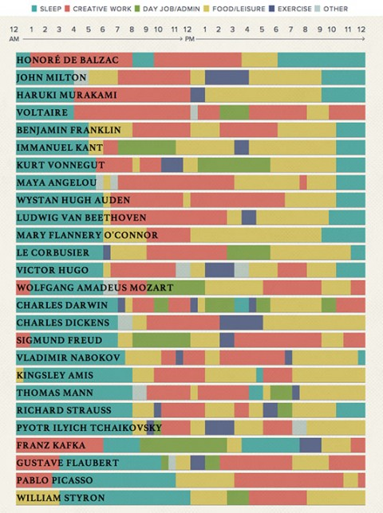
Notes:
What if you tracked the amount of pages devoted to each character in the progression through the novel?

Slide 7
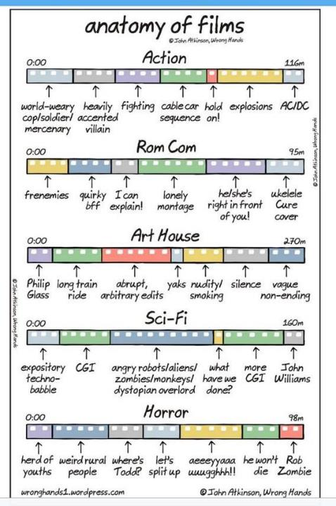
Notes:
Same idea as Slide 6. Just funny.

